Slide 1
McDonald’s Food Nutrition Data Analysis
-By Ruchitha Rachamalla

Slide 2
McDonald's
McDonald's Corporation is an American-based multinational fast food chain, founded in 1940 in San Bernardino, California, United States.
McDonald's is the world's largest restaurant chain by revenue serving over 69 million customers daily in over 100 countries in more than 40,000 outlets

Slide 3
History Of McDonald's
The McDonald brothers, Richard and Maurice, founded McDonald's in 1940 in San Bernardino, California.
Ray Kroc helped the brothers grow their business into a national chain.
The McDonald brothers sold the business to kroc in 1961

Slide 4
McDonald’s Menu
McDonald’s is best known for its burgers,fries,Big Mac,Quarter pounder,Egg McMuffin sandwiches.
And other items like Beverages,Salads,Milkshakes and Chicken Etc.
McDonald’s has been subjected to criticism over the health effects of its products

Slide 5
Problem statement :
Analyse the given dataset and make different predictions and draw meaningful conclusion so that it should be benificial for both company as well as customer.
Also state what can we learn from different predictions.
Prepare the report which can show how the customer could plan their meal.

Slide 6
Business benefits of the analysis
By analyzing nutrition value of the food items by the MacDonald’s, it will be easier to the customer to plan their meal according to their requirement.
This analysis report can attract to the customer who is very health conscious and believe in the past criticism of the MacDonald about unhealthy food items.
Customer who is on special diet due to different health problems such as overweight, vitamins deficiency anemia etc can also enjoy the MacDonald’s food items by checking nutrition values of the food items.
This report may lead to company revenue growth. Also company reputation and legacy may save from further criticism over the food.

Slide 7
About Dataset :
Given dataset contains different food items with their fat, calories, cholesterol, carbohydrates, sodium, dietary fibre, sugar, proteins, vitamins contents.
McDonalds provides 9 different food category which contains 260 different food items.
Table in the given dataset contains 260 rows and 24 columns. It means that there is no duplicate values in the given dataset.

Slide 8
Inspiration
How many calories does the average McDonald's value meal contain?
How much do beverages, like soda or coffee, contribute to the overall caloric intake?
Does ordered grilled chicken instead of crispy increase a sandwich's nutritional value?
What about ordering egg whites instead of whole eggs?
What is the least number of items could you order from the menu to meet one day's nutritional requirements?

Slide 9
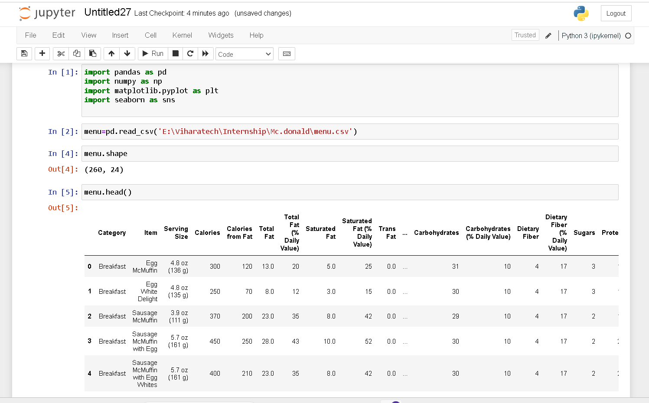

Slide 10
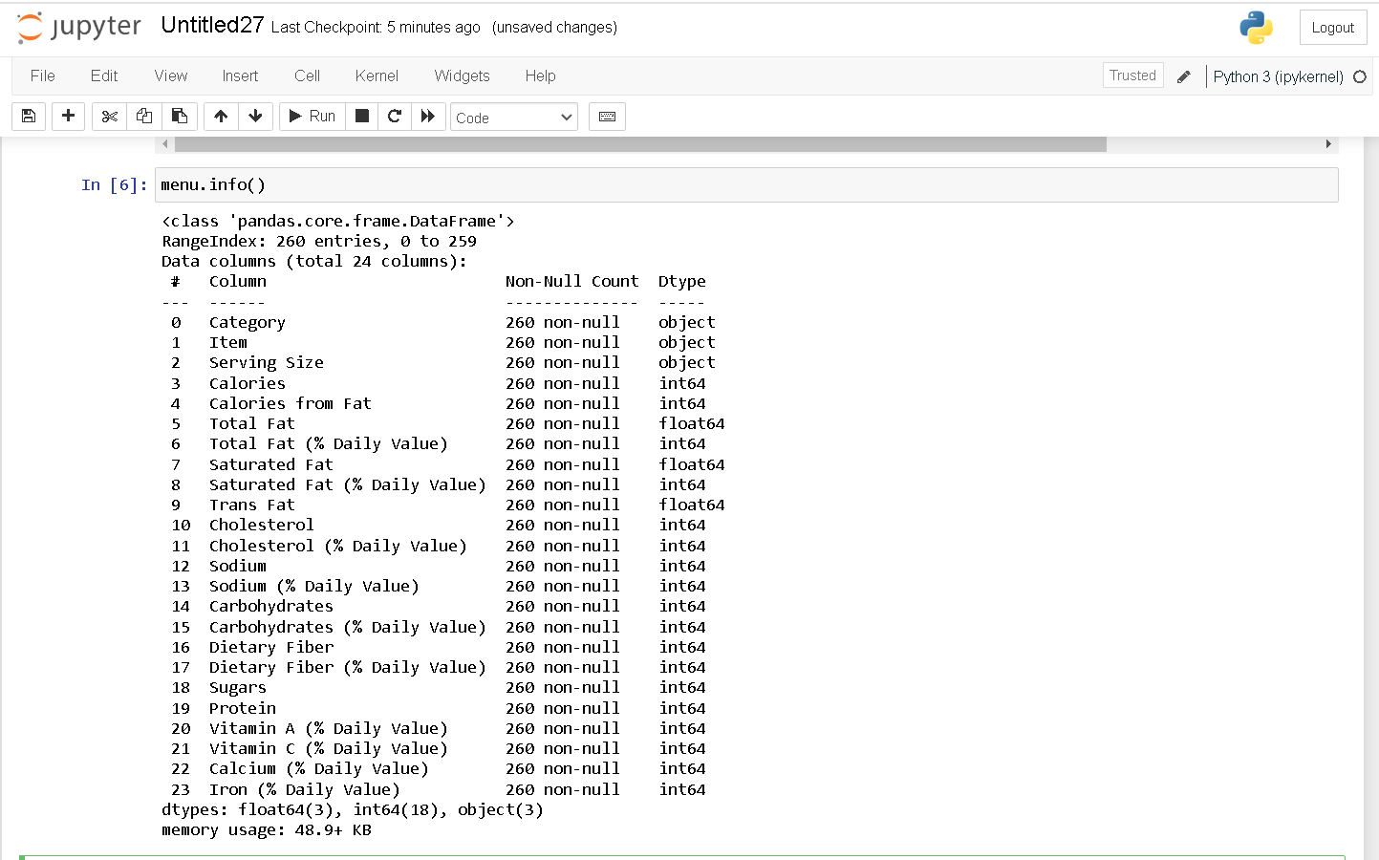

Slide 11
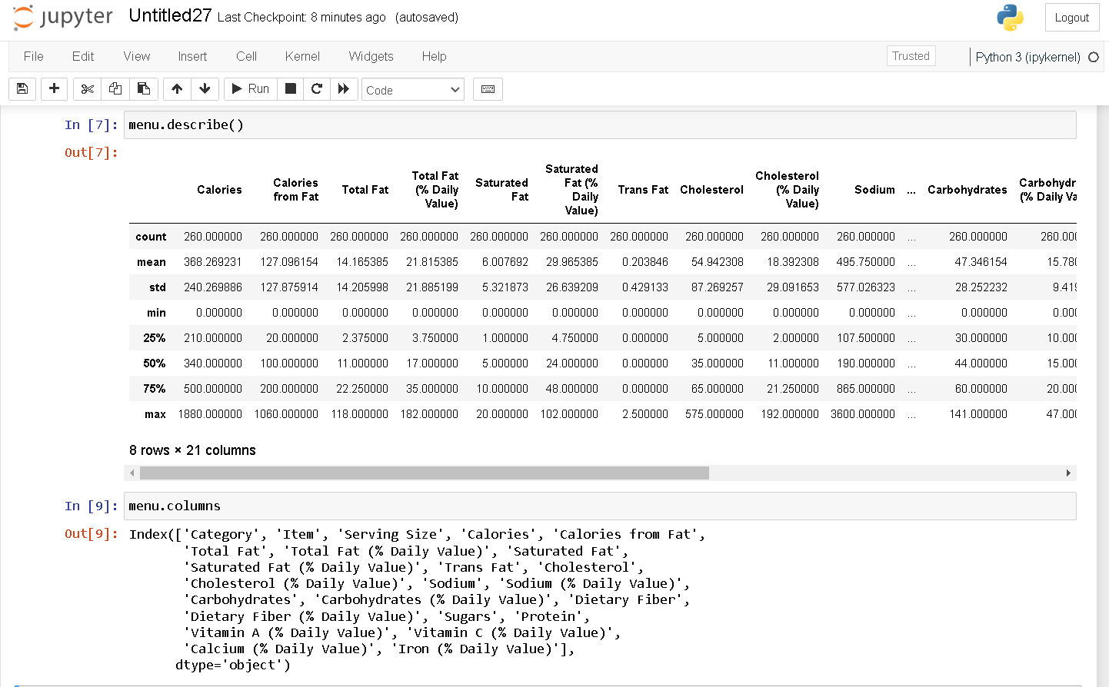

Slide 12
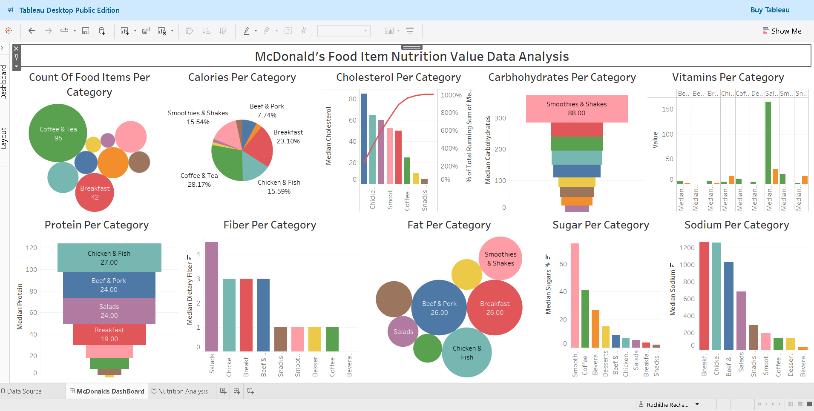

Slide 13
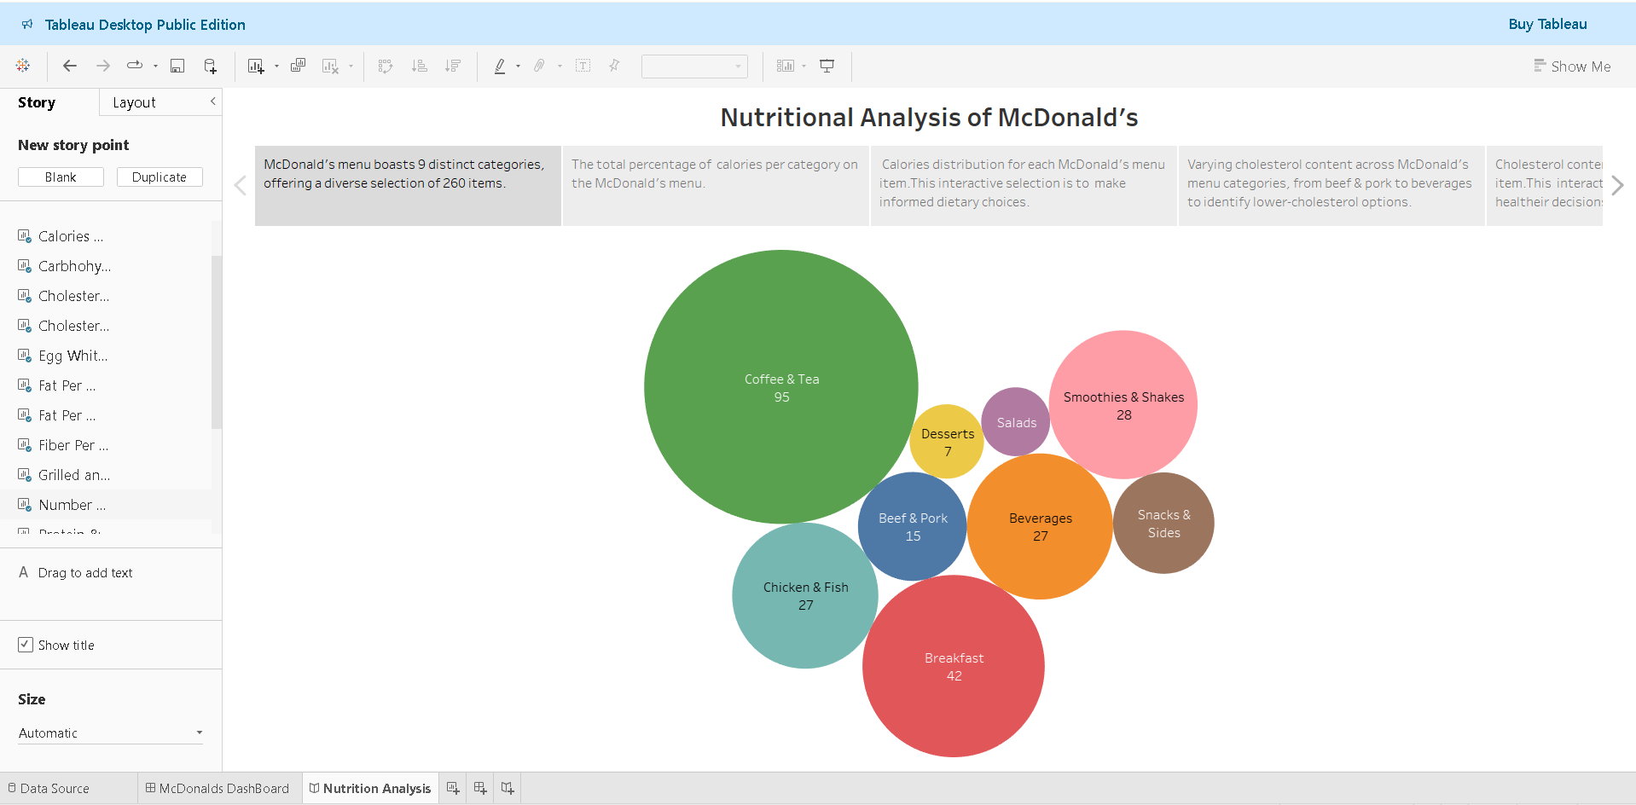

Slide 14
McDonald’S Data Analysis DashBoard And StoryTelling Links
https://public.tableau.com/app/profile/ruchitha.rachamalla/viz/McDonaldsDashBoard/McDonaldsDashBoard
https://public.tableau.com/app/profile/ruchitha.rachamalla/viz/McDonaldsStory_17400554543390/NutritionAnalysis

Slide 15
Thank You

